Slide 1
Perspective Projection
(General Purpose)

Slide 2
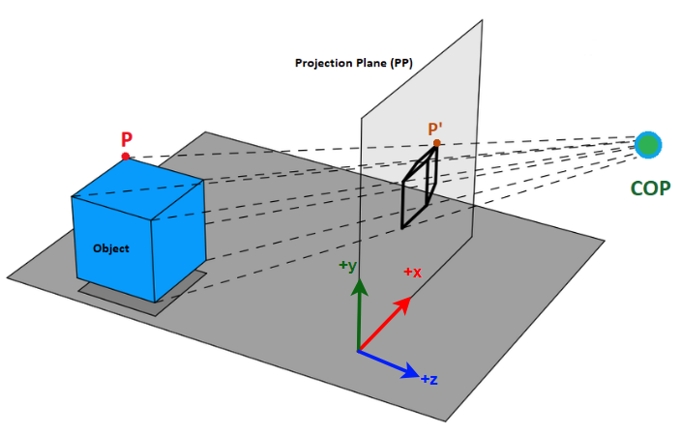
Perspective Projection Overview
In case of General Purpose Perspective Projection, the COP is not necessarily on the z-axis

Slide 3
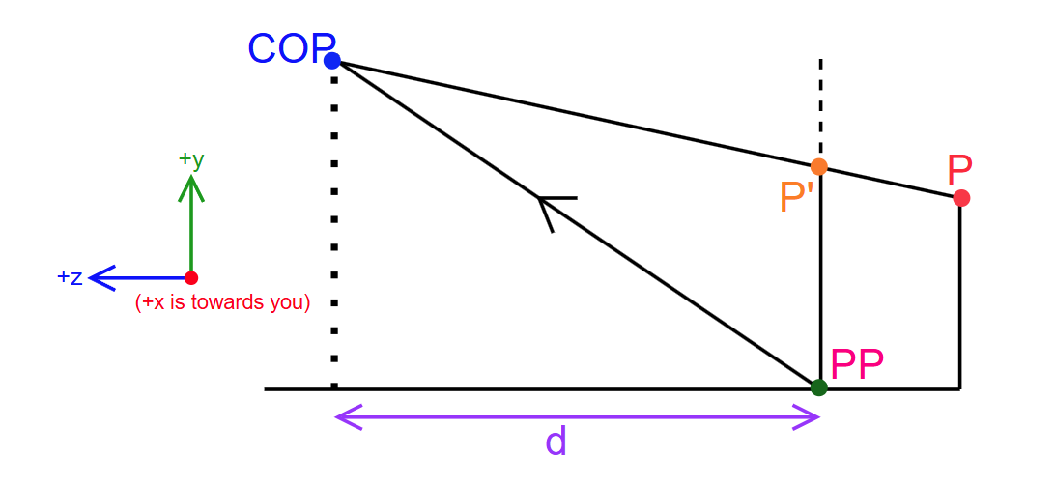
Scenario
COP is at an arbitrary point, not necessarily on the z-axis
We don't care if COP or PP is at origin or not.
The distance between COP and PP (expressed as d) is the z-distance between them.

Slide 4
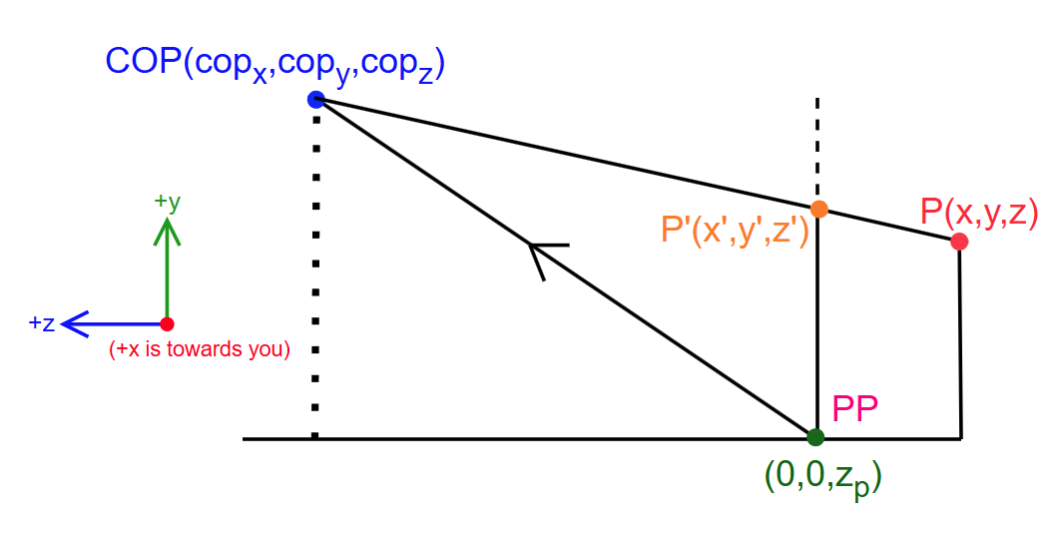
Scenario
COP is expressed component-wise as (cop_{x}, cop_{y}, cop_{z})
The z-axis pierces through the PP, the piercing point is (0, 0, z_{p})
The difference between cop_{z} and z_{p} is equals to d

Slide 5
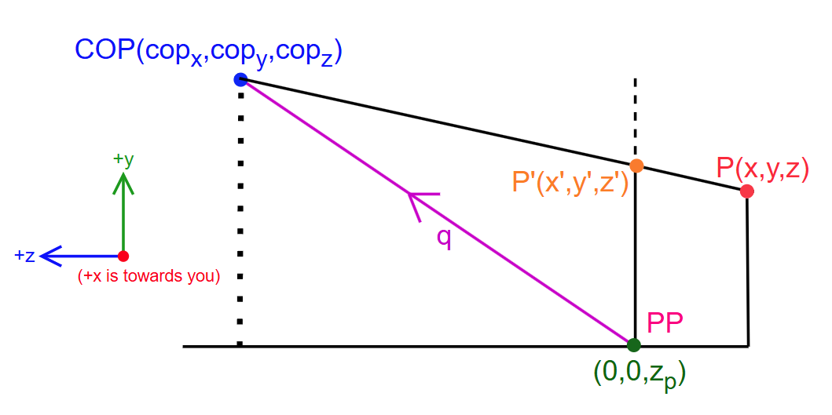
Scenario
We consider a vector called q that goes from (0, 0, z_{p}) to COP
So, q = (qx, qy, qz) = (cop_{x}, cop_{y}, cop_{z}) - (0, 0, z_{p}) = (cop_{x}, cop_{y}, cop_{z}-z_{p})
(qx, qy, qz) is sometimes expressed as (Qdx, Qdy, Qdz)

Slide 6
Scenario
q_{x} = cop_{x}
q_{y} = cop_{y}
q_{z} = cop_{z} - z_{p}
cop_{x} = q_{x}
cop_{y} = q_{y}
cop_{z} = z_{p}+ q_{z}
……..1(a)
……..1(b)
……..1(c)

Slide 7
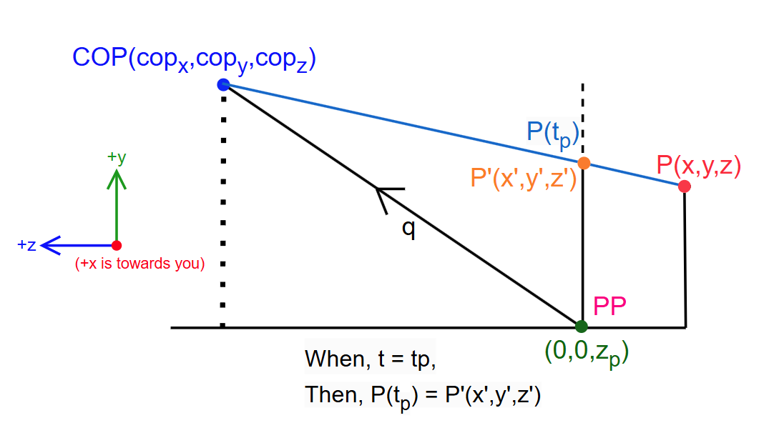
Scenario
We consider a parametric line segment that goes between COP and P
This line segment is basically our projection ray

Slide 8
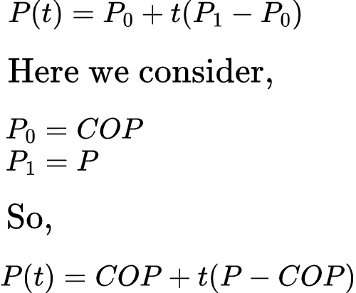
Scenario
At some point, for a certain value of t, P(t) will be the same as P'
We call that t value t_{p}
……..(2)

Slide 9
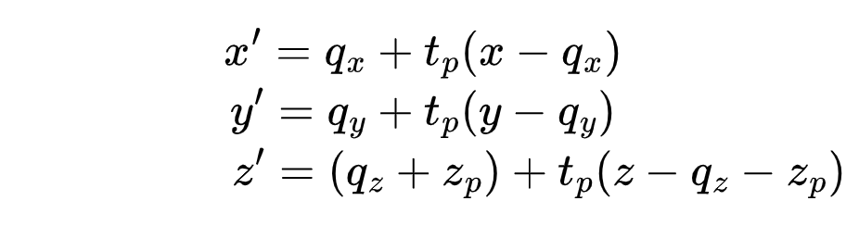
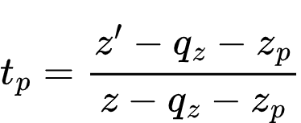
Breaking the equation the last equation into x, y, z components
……..3(a)
……..3(b)
……..3(c)
We need to remove t_{p} from these equations, since we don't know the value of t_{p}
Using the equation of z' we can write:

Slide 10
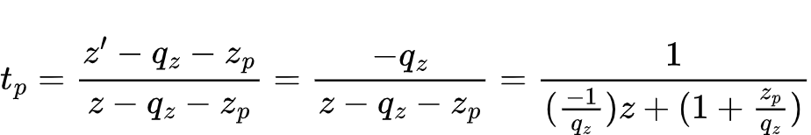
Since P'(x',y',z') and (0,0,z_{p}) both reside on the same plane (the PP), their z value are the same.
which means:
z' = z_{p} ……..(4)
(Remember this equation)
Now we substitute the value of t_{p} in the equations of x' and y' from before

Slide 11
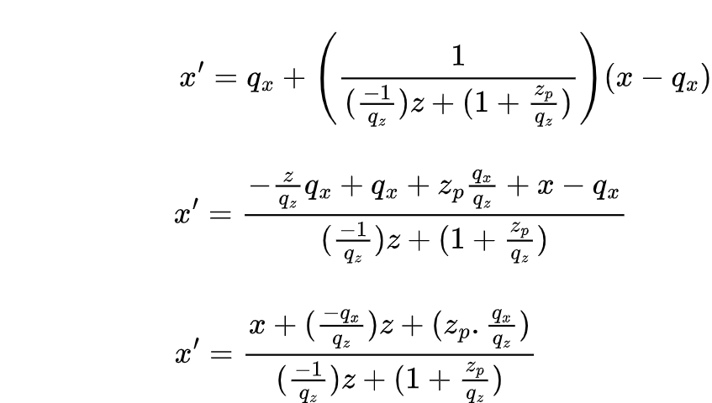
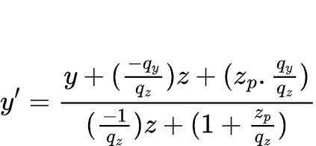
For x'
……..5(a)
For y', following the same way
……..5(b)

Slide 12
For x'
Notice how they have the same denominator (Remember this)
……..5(a)
For y', following the same way
……..5(b)

Slide 13
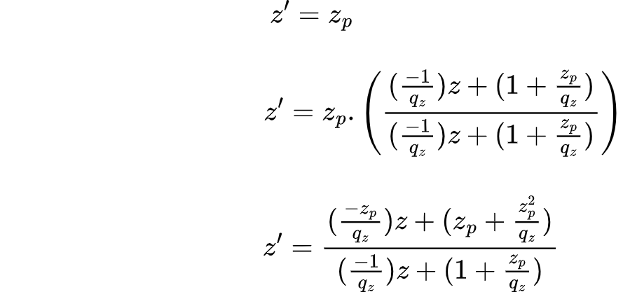
For z'
[Ok, but it lacks the common denominator]
[multiply by denominator/denominator]
[multiply the above part with z_{p}]
[keep the bottom part intact]
We've brought the common denominator present in x' and y' (Remember this)
……..5(c)

Slide 14
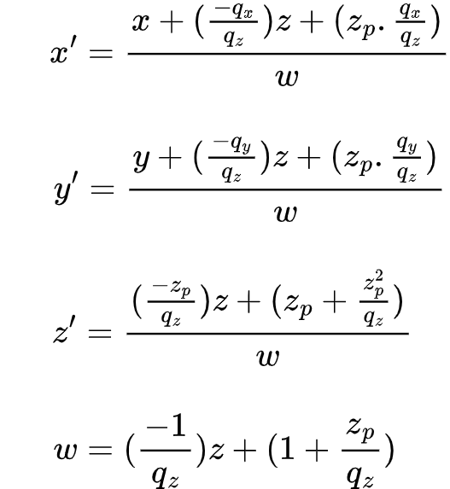
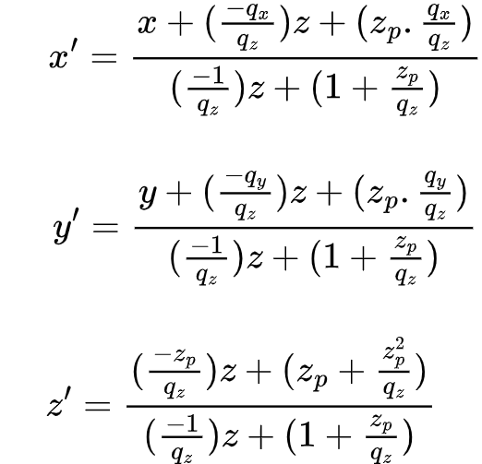
All in one place
We can call the common denominator "w"

Slide 15
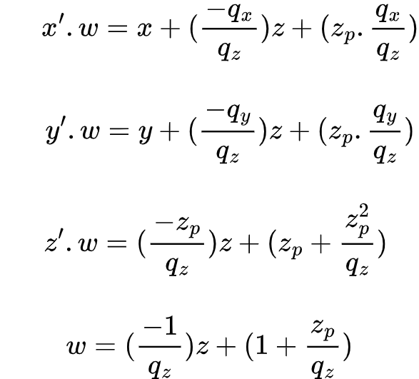
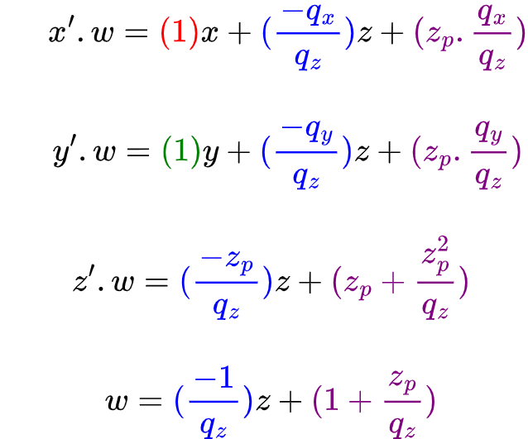
Moving "w" to the L.H.S
Same thing, but with color coded coefficients
Coefficients Color Coding:
(x = red, y = green, z = blue, leftover = purple)

Slide 16
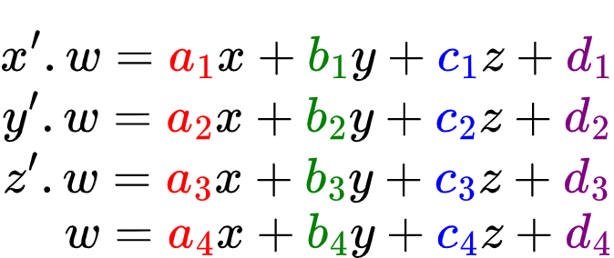
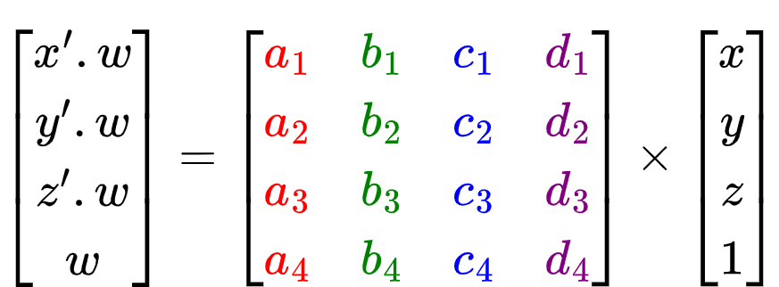
Strategy: Converting x', y', z' equations to a 4x4 matrix

Slide 17
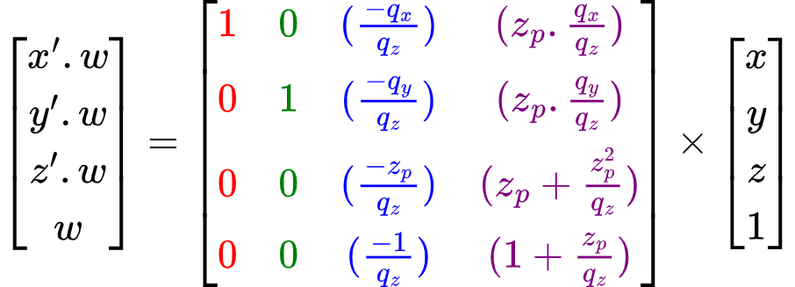
Ultimate Matrix System
We only need to know the constants q_{x}, q_{y}, q_{z}, z_{p} to build the matrix

Slide 18
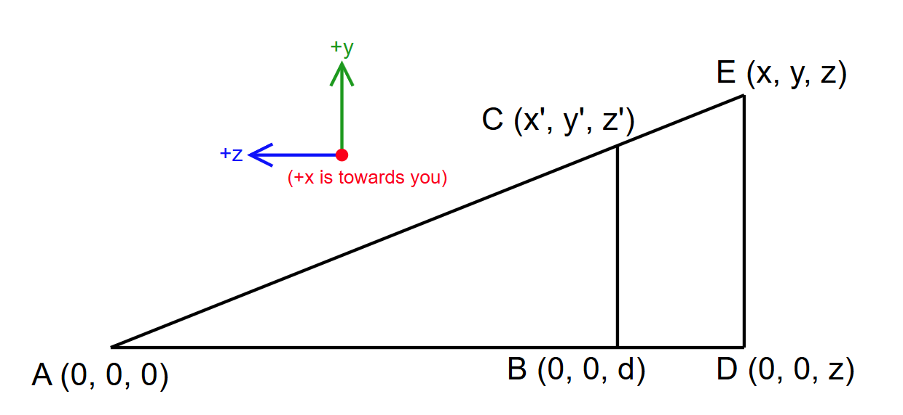
Getting Simple Perspective Projection Matrix from the General One (COP at Origin)
COP = A = (0, 0, 0)
(0, 0, z_{p}) = B = (0, 0, d)
So, z_{p} = d
Vector q(qx, qy, qx) = COP - (0, 0, z_{p}) = (0, 0, 0) - (0, 0, d) = (0, 0, -d)
So, q_{x} = 0 and q_{y} = 0 and q_{z} = -d

Slide 19
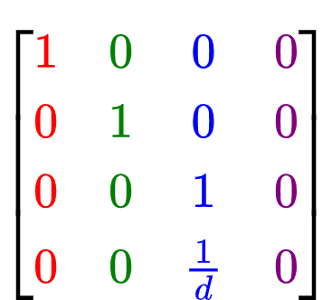
Getting Simple Perspective Projection Matrix from the General One (COP at Origin)
COP = A = (0, 0, 0)
(0, 0, z_{p}) = B = (0, 0, d)
So, z_{p} = d
Vector q(qx, qy, qx) = COP - (0, 0, z_{p}) = (0, 0, 0) - (0, 0, d) = (0, 0, -d)
So, q_{x} = 0 and q_{y} = 0 and q_{z} = -d

Slide 20
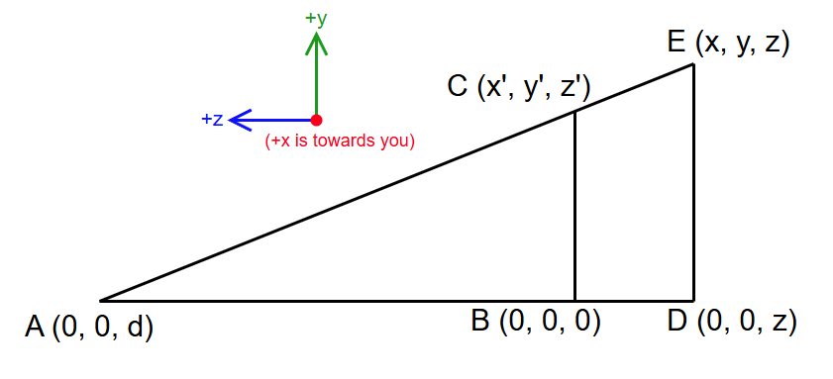
Getting Simple Perspective Projection Matrix from the General One (PP at Origin)
COP = A = (0, 0, d)
(0, 0, z_{p}) = B = (0, 0, 0)
So, z_{p} = 0
Vector q(qx, qy, qx) = COP - (0, 0, z_{p}) = (0, 0, d) - (0, 0, 0) = (0, 0, d)
So, q_{x} = 0 and q_{y} = 0 and q_{z} = d

Slide 21
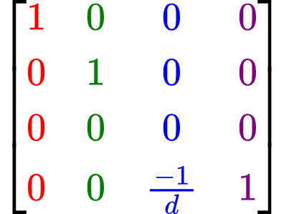
Getting Simple Perspective Projection Matrix from the General One (PP at Origin)
COP = A = (0, 0, d)
(0, 0, z_{p}) = B = (0, 0, 0)
So, z_{p} = 0
Vector q(qx, qy, qx) = COP - (0, 0, z_{p}) = (0, 0, d) - (0, 0, 0) = (0, 0, d)
So, q_{x} = 0 and q_{y} = 0 and q_{z} = d

Slide 22
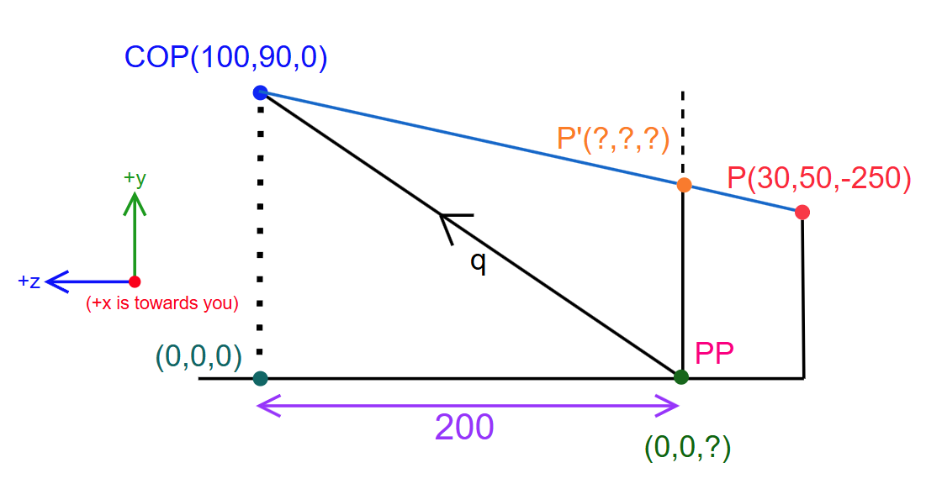
Example: For COP at (100, 90, 0), calculate the projected point P' for a point P(30, 50, -200) where the Projection Plane (PP) is 200 units away from COP
The z level of COP is 0, while the z level of P is -250.
Since there's a projection on the plane, the plane is likely to be between these two points.
The plane itself will have a z value that's between 0 and -250 (which is a negative value).
It's already said the distance between COP and PP is 200 units. This distance is across z-axis.
Thus, the z value of PP is (0-200) = -200. This is the z_{p} value.
So, z_{p} = -200

Slide 23
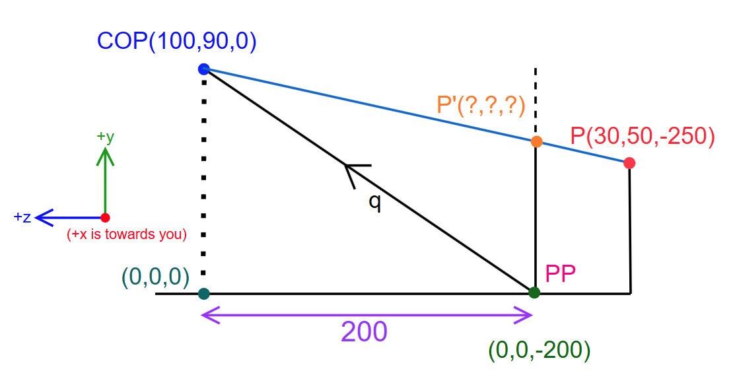
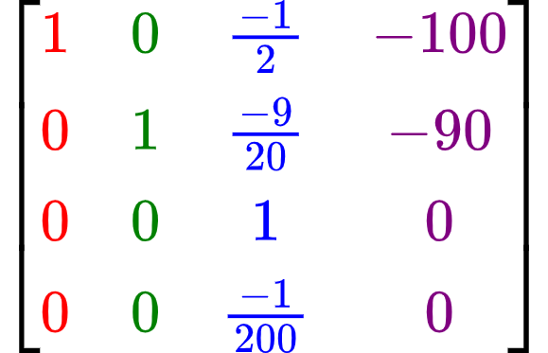
Example: Continued…
Since we've got the z_{p}, we can now calculate the q vector.
q = COP - (0,0,z_{p}) = (100,90,0) - (0,0,-200) = (100,90,200)
So, q_{x} = 100 and q_{y} = 90 and q_{z} = 200 (and z_{p} = -200 from previously)
We now but these values into the general purpose perspective projection matrix, we will get the matrix from the upper-right.

Slide 24
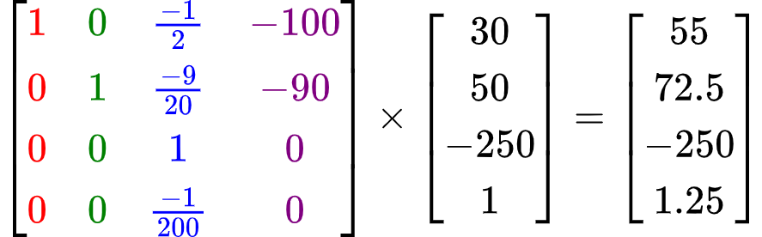
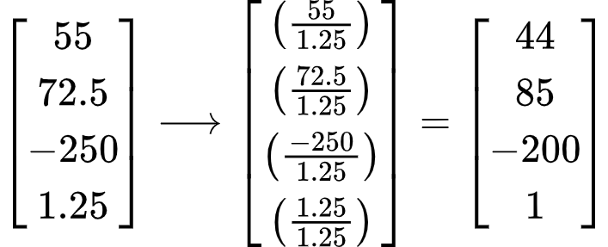
Example: Continued…
Now, simply multiply the point P as a column vector.
Almost done, all we need to do is divide each value in the result by "w" which is 1.25

